Slide 1
Concentrations
جامعة البصرة– كلية الصيدلة
فرع الكيمياء الصيدلانية – المرحلة الأولى
الكيمياء التحليلية
الأستاذ االدكتور
حسين ناصر السلمان
2025-2024

Slide 2
Molarity
16.2
Molarity
How do you calculate the molarity of a solution?

Slide 3
Molarity
16.2
Molarity (M) is the number of moles of solute dissolved in one liter of solution.
To calculate the molarity of a solution, divide the moles of solute by the volume of the solution.

Slide 4
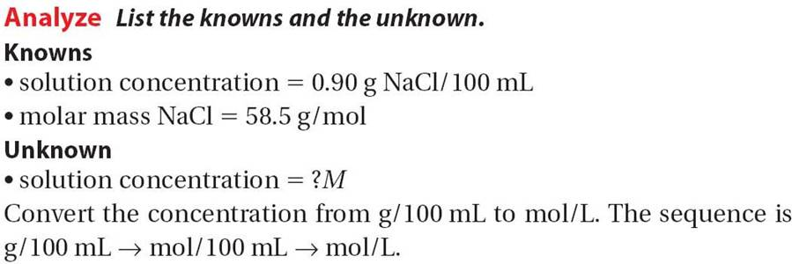
16.2

Slide 5
16.2

Slide 6
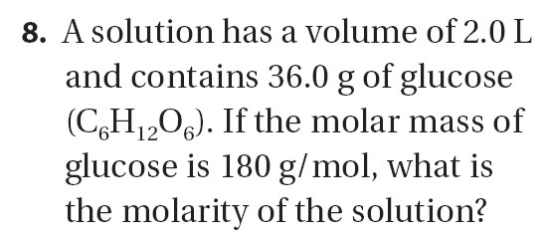
for Sample Problem 16.2

Slide 7
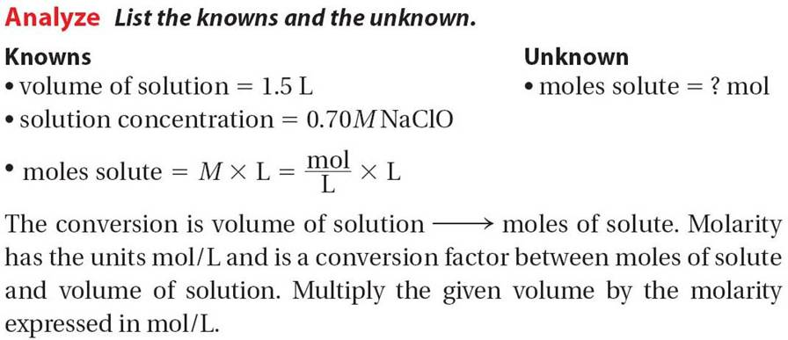
16.3

Slide 8
Sample Problem 16.3
16.3

Slide 9
for Sample Problem 16.3

Slide 10
Making Dilutions
16.2
Making Dilutions
What effect does dilution have on the total moles of solute in a solution?
Diluting a solution reduces the number of moles of solute per unit volume, but the total number of moles of solute in solution does not change.

Slide 11
Making Dilutions
16.2
The total number of moles of solute remains unchanged upon dilution, so you can write this equation.
M₁ and V₁ are the molarity and volume of the initial solution, and M₂ and V₂ are the molarity and volume of the diluted solution.

Slide 12
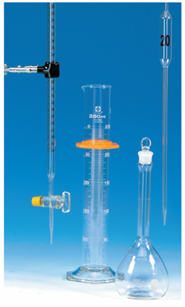
Making Dilutions
16.2
Volume-Measuring Devices
Notes:
The photo shows a buret, a graduated cylinder, a volumetric flask, and a volumetric pipet. These are just some examples of volume-measuring devices.

Slide 13
16.4

Slide 14
16.4

Slide 15
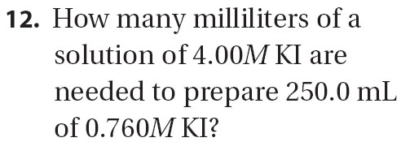
for Sample Problem 16.4

Slide 16
Percent Solutions
16.2
Concentration in Percent
(Volume/Volume)

Slide 17
16.5

Slide 18
16.5

Slide 19
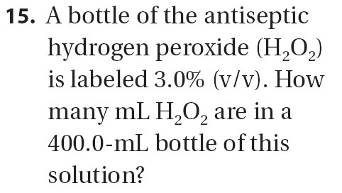
Practice Problems For Sample Problem 16.5
for Sample Problem 16.5

Slide 20
Percent Solutions
16.2
Concentration in percent
(mass/mass)

Slide 21
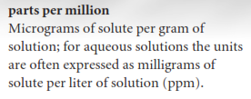

Slide 22
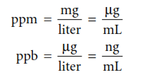
Parts per million
16.2
Concentration in parts per million (ppm)
(To complete)

Slide 25
16.2 Section Quiz.
1. To make a 1.00M aqueous solution of NaCl, 58.4 g of NaCl are dissolved in
1.00 liter of water.
enough water to make 1.00 liter of solution
1.00 kg of water.
100 mL of water.

Slide 26
16.2 Section Quiz.
2. What mass of sodium iodide (NaI) is contained in 250 mL of a 0.500M solution?
150 g
75.0 g
18.7 g
0.50 g
I = 127 g/mol, Na = 23 g/mol.

Slide 27
16.2 Section Quiz.
4. In a 2000 g solution of glucose that is labeled 5.0% (m/m), the mass of water is
2000 g.
100 g.
1995 g.
1900 g.

Slide 29
16.2 Section Quiz.
4. In a 2000 g solution of glucose that is labeled 4.0 ppm, the mass of glucose is
2000 g.
100 g.
1995 g.
0.0080 g.
ppm= mg/Kg
ppm = mg/L
μg/g

Slide 30
THANKS

